Slide 1
CSE291- Introduction to Software Engineering (FALL 2022)
Lecture 6
RAD and Agile Software Development

Slide 2
Objectives
understand how an iterative, incremental software development approach leads to faster delivery of more useful software
understand the differences between agile development methods and software development methods that rely on documented specifications and designs
know the principles, practices and some of the limitations of
extreme programming

Slide 3
Rapid Application Development
Rapid development and delivery is now often the most important requirement for software systems –why?
Businesses now operate in a rapidly changing environment –they have to respond to new opportunities
Software has to evolve quickly to reflect changing business needs.

Slide 4
RAD (Rapid Application Development)
“Rapid Application Development (RAD) is a development lifecycle designed to give much faster development and higher-quality results than those achieved with the traditional lifecycle.”

Slide 5
RAD(Rapid Application Development)
RAD takes advantage of automated tools and techniques.
RAD replaces hand-design and coding processes, which are dependent upon the skills of isolated individuals, with automated design and coding
The availability of powerful CASE (Computer Aided Software Engineering) software makes it possible for developers to create systems much faster than ever before.

Slide 6
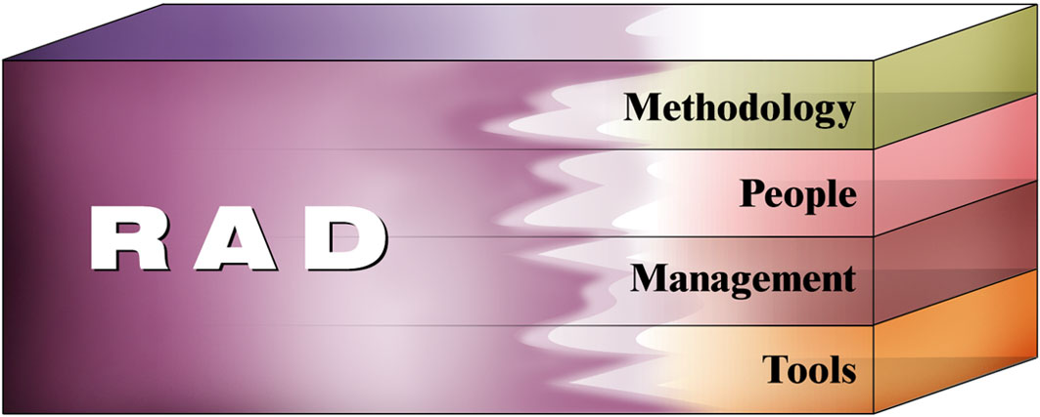
Essential Aspects of RAD

Slide 7
RAD(Rapid Application Development)
Methodology
Combining the best available techniques
Using evolutionary prototypes/ incremental
Using best suitable requirement elicitation technique for requirement gathering and review design
Selecting a set of CASE tools for modeling, prototyping and code reusability.
People
Type of project team required
Management
Management’s commitment in providing faster and timely Application
Tools
Computerized tools

Slide 8
Structure of RAD Life Cycle
Requirement Planning – Concept definition Stage
Defines Business functions /Requirements
Determine the system’s scope.
User Design – Functional Design Stage
uses workshops
To model the system’s data and processes
To build a working prototype of critical system components(I require)
Construction – Development Stage
completes the construction of application system
Implementation – Deployment Stage
Many of the programming components have already been tested since RAD emphasis reuse. This reduces overall testing time. But new components must be tested and all interfaces must be fully exercised.

Slide 9
Advantages and Disadvantages
RAD reduces the development time and reusability of components help to speed up development.
For large projects RAD require highly skilled engineers in the team. Both end customer and developer should be committed to complete the system in a much abbreviated time frame. If commitment is lacking RAD will fail.

Slide 10
Agile Software Development

Slide 11
An Agile Process
Agile means being able to “Deliver quickly. Change quickly. Change often”
Develops software iteratively
Delivers multiple ‘software increments’
Adapts as changes occur

Slide 12
The Manifesto for Agile Software Development
“We are uncovering better ways of developing software by doing it and helping others to do it. Through this work we have come to value:
Working software over comprehensive documentation
Customer collaboration
Responding to change over following a plan

Slide 13
What is “Agility”?
Effective (rapid and adaptive) response to change
Effective communication among all stakeholders
Drawing the customer onto the team
Organizing a team so that it is in control of the work performed
Rapid, incremental delivery of software

Slide 14
Agile Process
Is driven by customer descriptions of what is required (scenarios)
Recognizes that plans are short-lived
Develops software iteratively with a heavy emphasis on construction activities
Delivers multiple ‘software increments’
Adapts as changes occur

Slide 15
The Principles Of Agile Methods
Principle | Description
Customer involvement | Customers should be closely involved throughout the development process. Their role is provide and prioritize new system requirements and to evaluate the iterations of the system.
Incremental delivery | The software is developed in increments with the customer specifying the requirements to be included in each increment.
People not process | The skills of the development team should be recognized. Team members should be left to develop their own ways of working.
Adapt change | Expect the system requirements to change and so design the system to accommodate these changes.
Maintain simplicity | Focus on simplicity in both the software being developed and in the development process. Wherever possible, actively work to eliminate complexity from the system.

Slide 16
Issues
Customer involvement - its success depends on having a customer who is willing and able to spend time with the development team and who can represent all system stakeholders.
Individual team members may not have suitable personalities. They may therefore not interact well with other team members.
Prioritizing changes can be extremely difficult, especially in systems where there are many stakeholders.
Maintaining simplicity requires extra work. Under pressure from delivery schedules, the team members may not have time to carry out desirable system simplifications.

Slide 17
Existing Agile Methods
Extreme Programming (“XP”)
Adaptive Software Development (ASD)
Scrum
Dynamic Systems Development Method (DSDM)
Feature Drive Development (FDD)
Lean Software Development (LSD)
Agile Modeling (AM)
Agile Unified Process (AUP)
Kanban, and DevOps.

Slide 18
Extreme Programming
Perhaps the best-known and most widely used agile method.
In extreme programming, all requirements are expressed as scenarios (called user stories), which are implemented directly as a series of tasks.
Programmers work in pairs and develop tests for each task before writing the code.
All tests must be successfully executed when new code is integrated into the system.
There is a short time gap between releases of the system.

Slide 19
Extreme Programming (XP)
XP Values
Communication(Be together with your customer and fellow programmers, and talk to each other )
Simplicity (Use simple design and programming practices, and simple methods of planning, tracking, and reporting)
Feedback(Test your program and your practices, using feedback to steer the project)

Slide 20
Extreme Programming Core Practices (A)
Principle or practice | Description
Incremental planning | Requirements are recorded on story cards The developers break these stories into development ‘Tasks’.
Small releases | The minimal useful set of functionality that provides business value is developed first. Releases of the system are frequent and incrementally add functionality to the first release.
Simple design | Enough design is carried out to meet the current requirements and no more.
Test-first development | An automated unit test framework is used to write tests for a new piece of functionality before that functionality itself is implemented.
Refactoring | All developers are expected to refactor / restructure the code continuously as soon as possible code improvements are found. This keeps the code simple and maintainable.

Slide 21
Extreme Programming Core Practices (B)
Pair programming | Developers work in pairs, checking each other’s work and providing the support to always do a good job.
Collective ownership | The pairs of developers work on all areas of the system, all the developers take responsibility for all of the code. Anyone can change anything.
Continuous integration | As soon as the work on a task is complete, it is integrated into the whole system. After any such integration, all the unit tests in the system must pass.
Sustainable pace | Large amounts of overtime are not considered acceptable as the net effect is often to reduce code quality and productivity
On-site customer | A representative of the end-user of the system (the customer) should be available full time. In an extreme programming process, the customer is a member of the development team and is responsible for bringing system requirements to the team for implementation.

Slide 22
The Extreme Programming Release Cycle

Slide 23
Example – Story Card For Downloading Document

Slide 24
Task Cards

Slide 25
Testing in XP
Test-first development and the use of automated test harnesses are major strengths of the XP approach.
Rather than writing the program code, then writing the tests of that code, test-first development means that the test is written before the code.

Slide 26
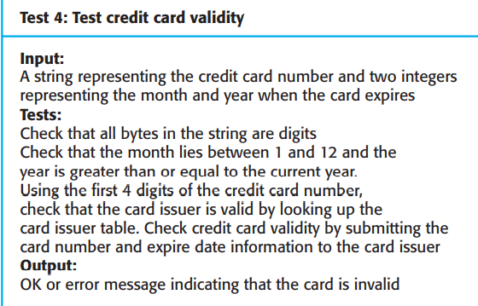
Test case description for credit card validity

Slide 27
Pair Programming
Another innovative practice that has been introduced is that programmers work in pairs to develop the software.
The use of pair programming has a number of advantages:
It supports the idea of common ownership and responsibility for the system. where the software is owned by the team as a whole and individuals are not held responsible for problems with the code.
It acts as an informal review process because each line of code is looked at by at least two people.

Slide 28
Pair Programming
It helps support refactoring, which is a process of software improvement. A principle of XP is that the software should be constantly refactored. That is, parts of the code should be rewritten to improve their clarity or structure.

Slide 29
Agile Method Applicability
Product development where a software company is developing a small or medium-sized product for sale.
Custom system development within an organization, where there is a clear commitment from the customer to become involved in the development process
Best suited to the development of small or medium-sized business systems and personal computer products.

Slide 30
Agile Method Applicability
Not well suited to large-scale systems development with the development teams in different places and where there may be complex interactions with other hardware and software systems.
Nor should agile methods be used for critical systems development where a detailed analysis of all of the system requirements is necessary to understand their safety or security implications.

Slide 31
Chapter Reading
Chapter 3, Agile Software Development,
Software Engineering by Ian Sommerville

